Slide 1
Dashboard For Business Stakeholders
PARTH BAMNOTE

Slide 2
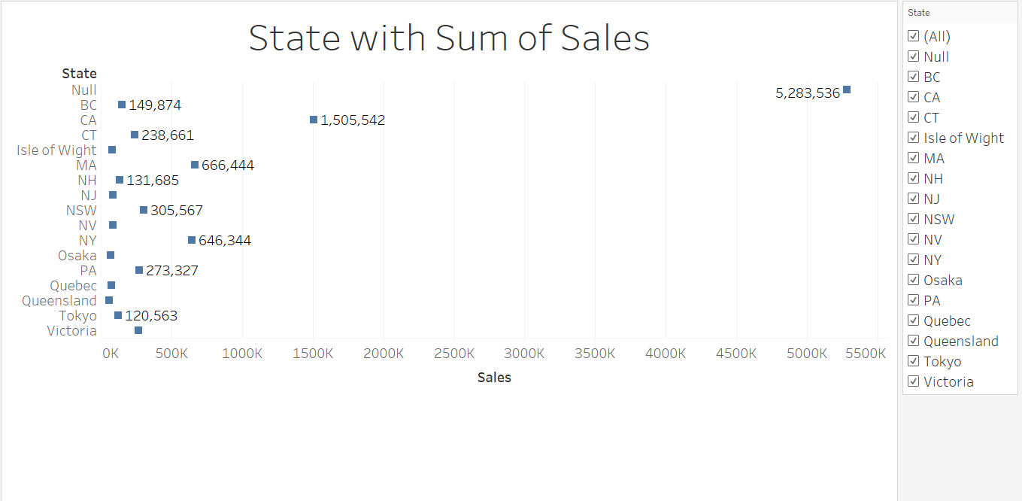
State with Sum of Sales

Slide 3
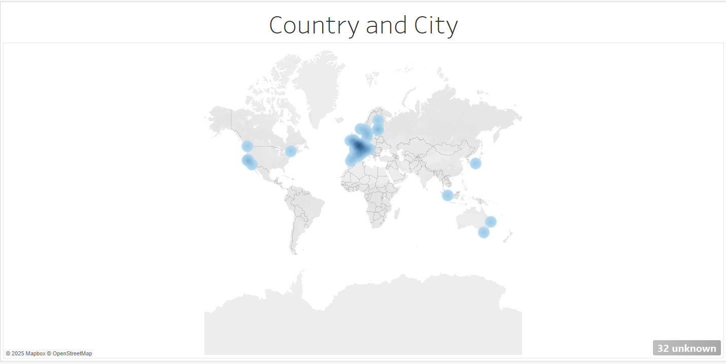
Country and City

Slide 4
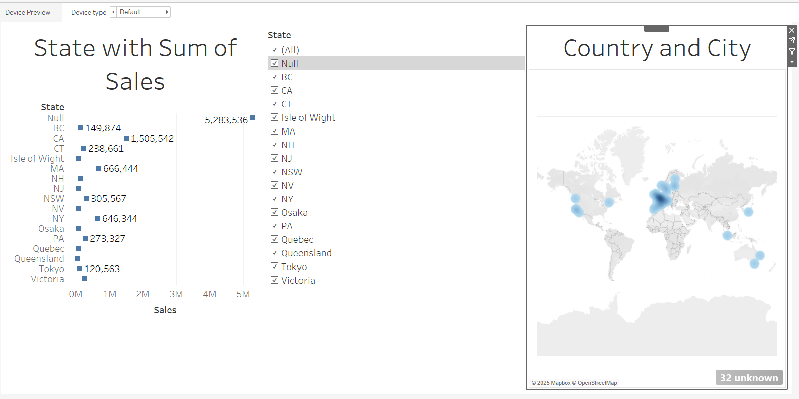
Dashboard

